Slide 1




Slide 1
Visualizing the Google Trends Dataset to understand consumer patterns
- Team 3
Ruta Kulkarni
Meera Ghaskadvi
Marisha Chopade

Slide 2

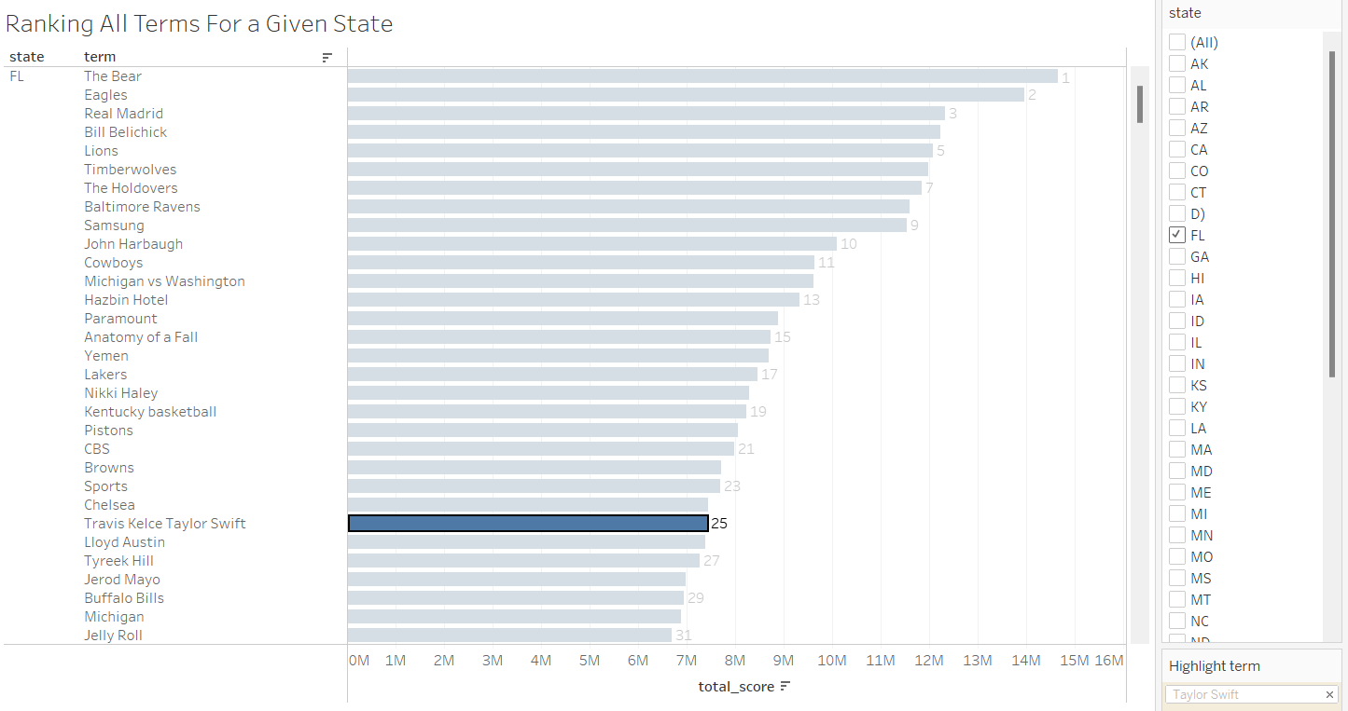
Summary ranking data per US state
Customizing Marketing Approaches with State-Specific Trend Insights to Maximize Profits and Gain a Competitive Advantage
The dashboard provides businesses with the ability to tailor their marketing strategy by allowing them to select specific terms relevant to their industry across various states
This data empowers businesses to optimize their marketing efforts and work towards achieving a competitive edge in trending topics within their target regions
Scenario: Hired by Taylor Swift to gauge trends in Florida for upcoming Eras Tour
Analysis and Interpretation:
Current trending terms helps understand Taylor Swift’s standing with the public of different states
Swift is interested in a concert in Florida, which will work in her favor as she is currently ranked 25th in the state. This data can be extrapolated to future months and plan marketing campaigns accordingly
State
2

Slide 3
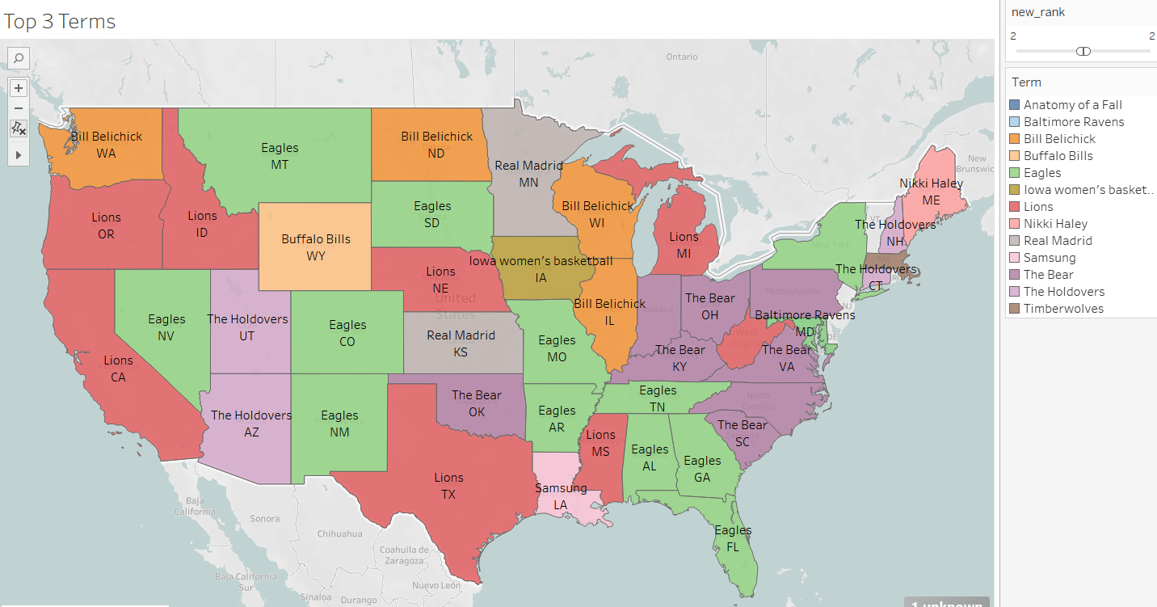
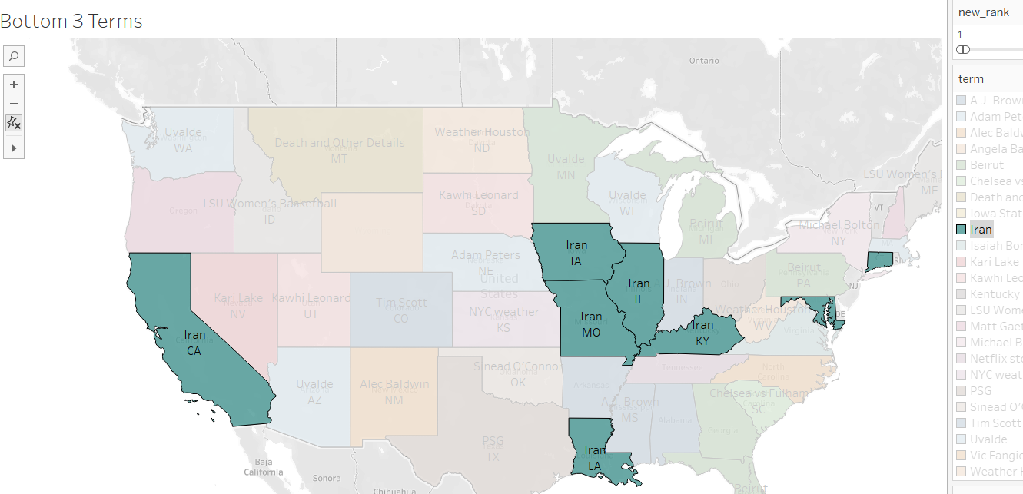
Assessing Top and Bottom Regional Terms to Inform PR and Marketing Decisions
Insights from Top Terms:
Utilizing top terms allows PR firms to proactively assess their clients' regional popularity, facilitating data-driven PR decision-making tailored to specific geographic markets
Top 3 terms per state (Filter using Rank and Term)
Shows “Iran” as the least trending term for highlighted states
Rank
Insights from Bottom Terms:
Business sectors can leverage this data to gauge whether their marketing concepts align with emerging trends that may be approaching the brink of unpopularity. Armed with such insights, they can then fine-tune and adapt their marketing strategies accordingly.

Slide 4
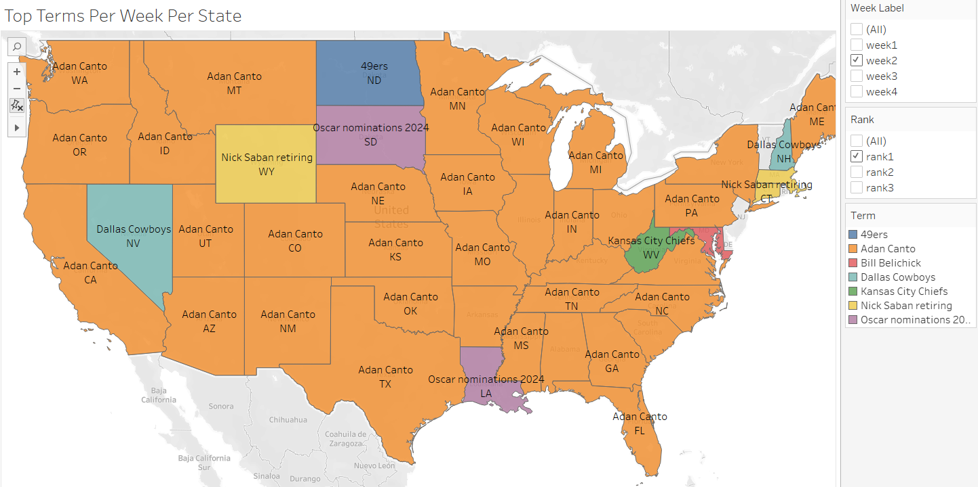
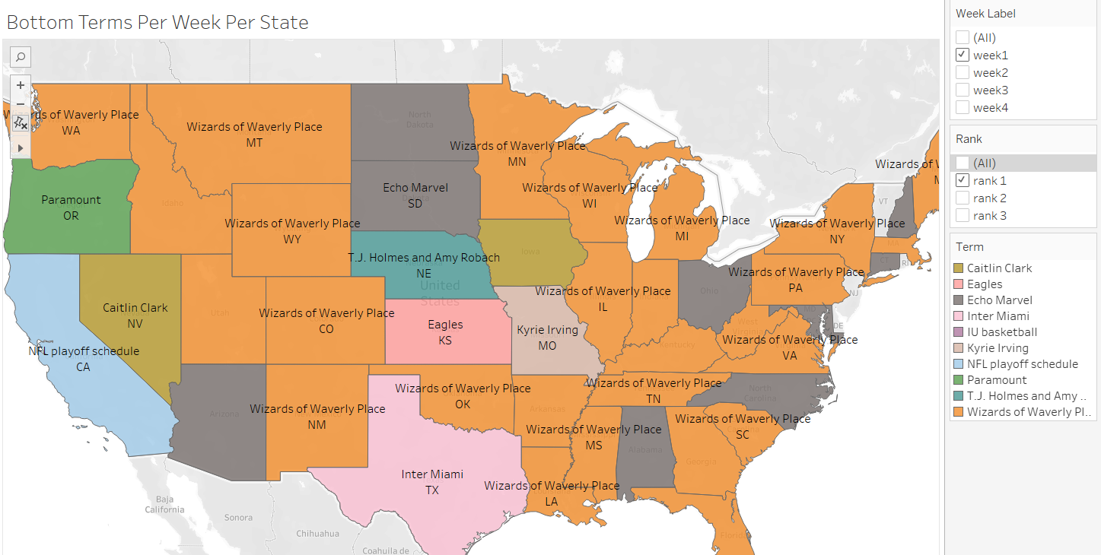
Regional Search Term Dynamics: Top & Bottom Weekly Trends Dashboard
Leverage this dashboard as a tool to analyze the cause-and-effect dynamics of past events. This invaluable resource empowers companies to gain profound insights into the impact of significant events on their marketing strategies
Observing the top and bottom terms, analysts can identify emerging cultural trends or shifts in public interest
Top 3 terms per week (Filter using Rank, Week and Term)
Bottom 3 terms per week (Filter using Rank, Week and Term)
Week
Rank
Notes:
Cause effect, ex. Some person signed up for a football team – effects of this event after this

Slide 5
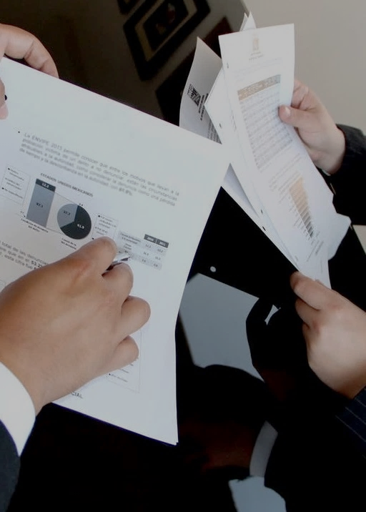
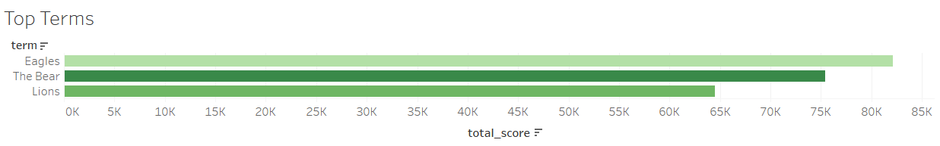



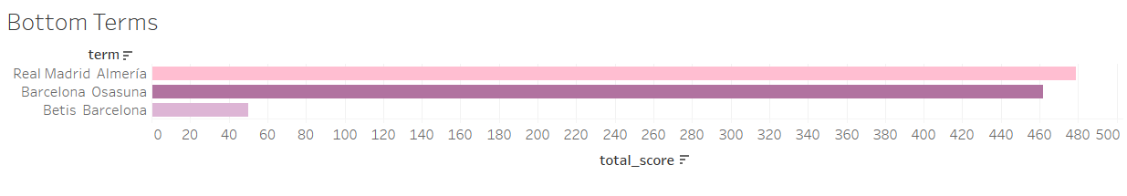
Optimize Marketing Impact by Leveraging Top and Bottom National Search Trends
National Trending Terms: Top & Bottom Rankings Analysis
This dashboard provides insights into the prevailing countrywide trending terms, making it a valuable resource for businesses gearing up for major marketing campaigns.
By leveraging this data, companies can strategically align their marketing and product developing strategies with the most prominent trends, ensuring their campaigns resonate with the broader national audience and maximize their reach and impact.
Monitor your competitors' use of trending terms to benchmark your strategies against industry standards.
Top Terms
Eagles
The bear
Lions
Terms
Total score
Bottom Terms
Real Madrid Almeria
Barcelona Osasuna
Betis Barcelona
Terms
Total score
Notes:
Superbowl – advertisement – 7m –Jason kelchy

Slide 6
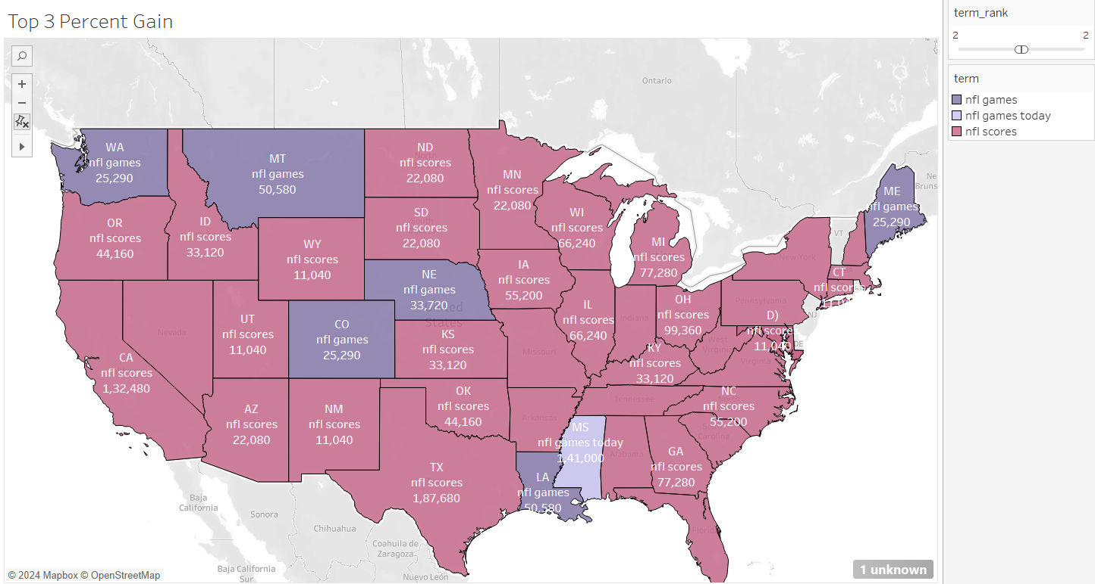
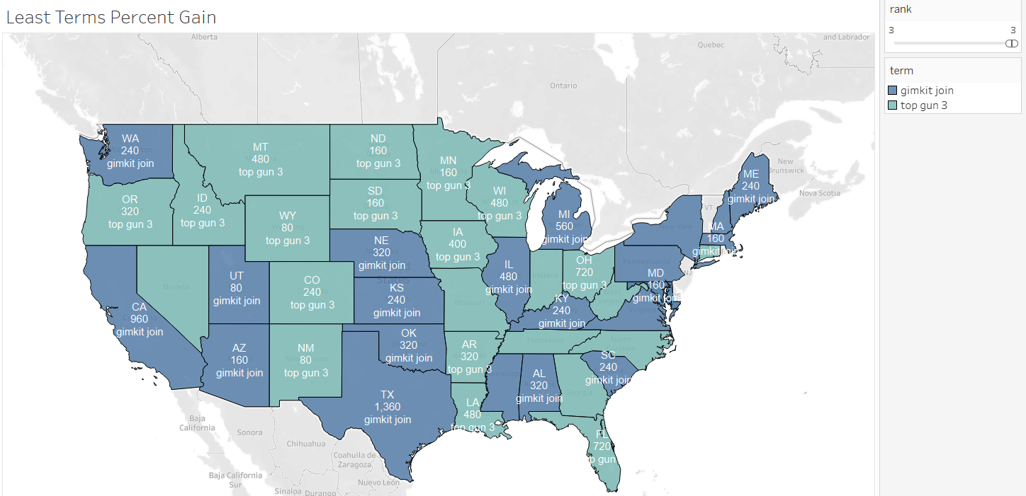
Enhance Strategic Decision-Making with Insights from Trending Term Popularity Shifts
This dashboard serves as a valuable tool for a company to gain insights into how trends have evolved and how the top terms have experienced a surge in popularity over a given timeframe. Additionally, it provides valuable insights into the performance of less popular terms over the past four weeks.
Consider launching products in states where related terms are gaining popularity
Align content creation with the terms that are gaining traction to increase engagement
Top 3 terms percent gain (Filter using Rank and Term)
Bottom 3 terms percent gain (Filter using Rank and Term)
Rank
Notes:
retrospection

Slide 7
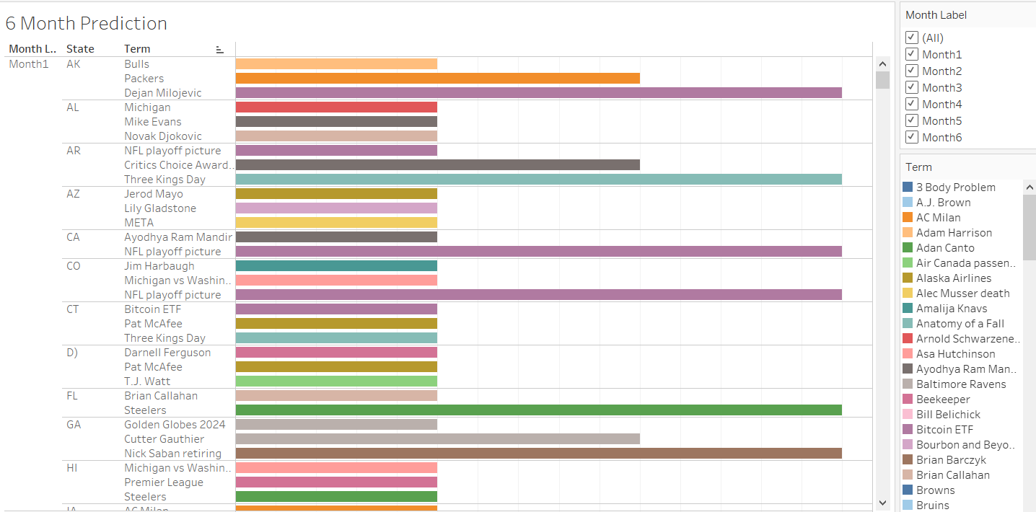
Leveraging Machine Learning to Forecast Six-Month Trending Topics for Enhanced Marketing and Event Strategy
Media companies can plan articles, blog posts, and videos around future trending topics to drive traffic and engagement.
Event organizers can plan and promote events based on predicted popular themes or topics. This dashboard helps companies allocate their advertising budgets more efficiently by focusing on terms that are predicted to gain traction.
Arima time series model: Uses present score to predict future score
Month
32.38
MAE value
35
RMSE value
$186.54
Social Media: Use future terms as hashtags in posts, make reels and shorts on that topic
1
2
Search Engine Optimization: Curation of web content based on terms
Event Planning: Align the theme of future events with trending terms, use social media for promotion
3

Slide 8
Harnessing Data-Driven Insights for Precision Marketing and Strategic Business Growth
These analytical dashboards serve as a pivotal tool for organizations seeking to capitalize on market trends within their strategic marketing initiatives. They empower analysts and marketers to quantify the influence of events on prevailing trends and gauge consumer sentiment regarding specific terms, thereby facilitating informed decision-making.
The granular state-specific insights empower businesses to craft targeted campaigns that resonate with local audiences, optimizing resource allocation and enhancing market penetration.
These dashboards offer analysts insightful foresight into the prospective traction of various terms, enabling enterprises to adeptly tailor their marketing campaigns. The intelligence provided is instrumental in guiding strategic decisions related to potential partnerships, collaborative ventures, and product innovation.
NOTE: Since multiple terms were having top 3 ranks, we have taken the highest score from those and chosen those terms

